Slide 1
Talend Development Best Practices
February 15, 2018
Presenter :

Slide 2
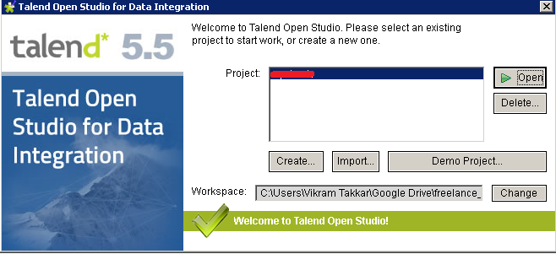
Talend workspace path should not contain any spaces.
Workspace paths to avoid:
c:\Open Project\Talend Open Studio\workspace
d:\My Projects\Talend\workspace
Recommended Workspace Path:
c:\Talend\workpace
d:\OpenProject\Talend\workspace
c:\MyProject\repository

Slide 3
Prefer creating Repository Metadata for data files.
Create Repository Metadata for DB connections and retrieve database table schema for DB tables.
Create Database connection using t<Vendor>Connection component and use this connection in the Job. Do not make new connection with every component.

Slide 4
Create a Repository Document corresponding to every Talend job including revision history.
Sample documentation Best Practise
Talend Job Description:
In this paragraph , white down the high level description and functionality of Talend Job
Revision History
1.0 04-10-2014 Initial Development
1.1 07-10-2014 Modification to Source and Target repository Schema
1.2 09-10-2014 Modification to transformation logic.

Slide 5
Never forget to perform Null Handling
Example #1 – Bad
if(myString.length() > 0) System.out.println(myString.toUpperCase());
Example #2 – Good
if(!Relational.ISNULL(myString) && myString.length() > 0) System.out.println(myString.toUpperCase());

Slide 6
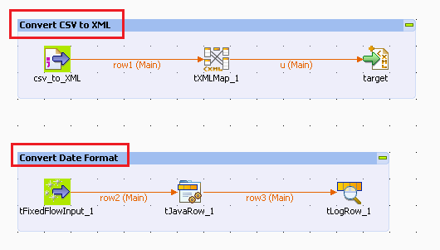
Provide Sub Job title for every sub job to describe the sub job purpose/objective.

Slide 7
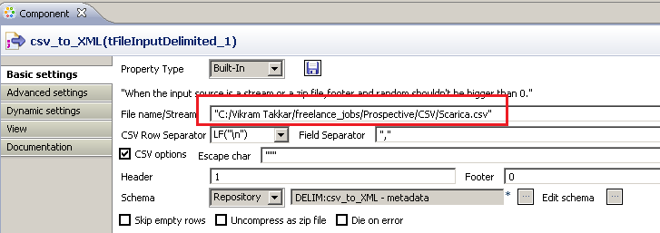
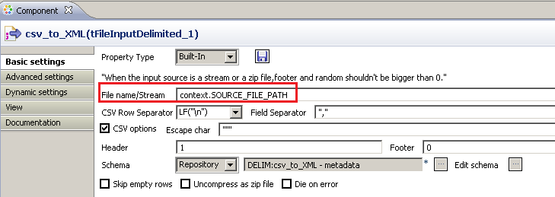
Avoid Hard Coding. Instead use Talend context variables.

Slide 8
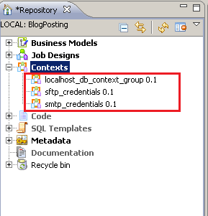
Create Context Groups in Repository
e.g. Context Group for
Database connections
FTP credentials
SMTP credentials etc.

Slide 9
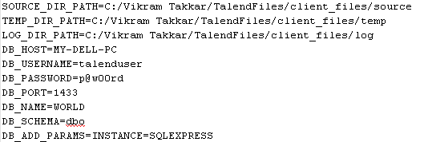
Use Talend.properties file to provide the values to context variables using tContextLoad

Slide 10
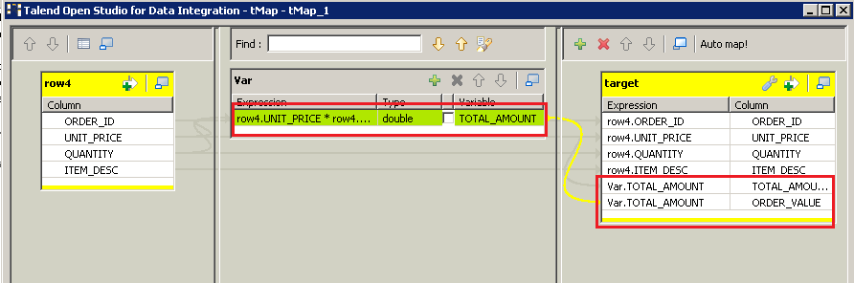
Create Variables in tMap and use the variables to assign the values to target fields.

Slide 11
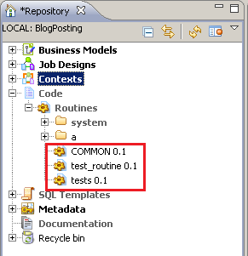
Create user routines/functions for common transformation and validation
e.g. Null Handling, checking a valid email id, removing extra spaces etc

Slide 12
Develop Talend job iteratively. First create a subjob and then test it.

Slide 13
Always Exit Talend open studio before shutting down the PC.

Slide 14
Questions?
Copyright © 2014 by Vikram Takkar. All Rights Reserved..

